Slide 1

Clustering of various applications
Present In google Playstore.
SUBMITTED BY – Akshat Saxena
SUBMITTED TO - Mr. Gopal Gupta

Slide 2
Outline:
1.Problem Statement
2.Objective
3.Motivation
4.Dataset Description
5.Preprocessing of Data
6.Machine learning Model

Slide 3
Problem Statement
The problem is to perform unsupervised learning on the dataset and perform clusters of apps ..like whether they are successful or not.

Slide 4

2. Objective
We want to classify the apps into different categories.
We have to visualize the dataset on the basis of features and type of apps to help in classification.
Machine will form categories analysing the data. .

Slide 5
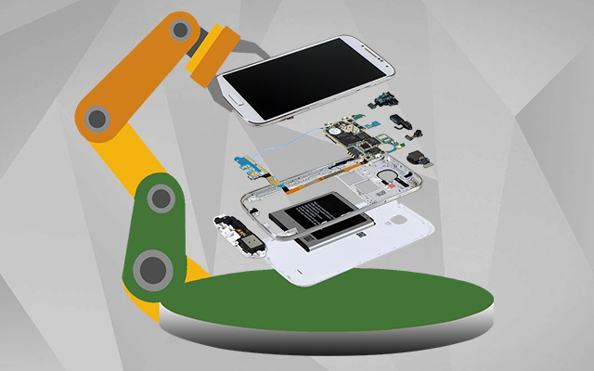
3.Motivation
The motivation for this project comes from seeing the increasing scope in the field of app development, as different sort of applications have become a necessity in today’s world.
Also on seeing other companies which have already analysed dataset and sold their product(apps) more than us and are continuing to make huge profits inspire to work on the dataset collected.
Considering the above, we have collected dataset.
We will implement machine
algorithm which will recommended us what specifications are required in the market for classification.

Slide 6
Dataset Description:
1)App: Application name 2)Category: Category to which the app belongs 3)Rating: Overall user rating of the app 4)Reviews: Number of user reviews for the app 5)Size: Size of the app 6)Installs: Number of user downloads/installs for the app 7)Type: Paid or Free 8)Price: Price of the app 9)Content Rating: Age group the app is targeted at - Children / Mature 21+ / Adult 10)Genres: An app can belong to multiple genres (apart from its main category). For example, a musical family game will belong to Music, Game, Family genres. 11)Last Updated: Date when the app was last updated on Play Store 12)Current Ver: Current version of the app available on Play Store 13)Android Ver: Minimum required Android version

Slide 7
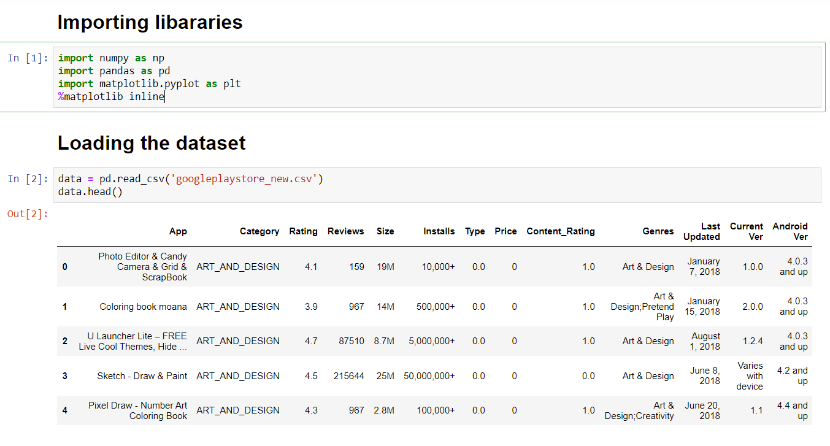
Importing Libraries

Slide 8
Loading the Dataset

Slide 9
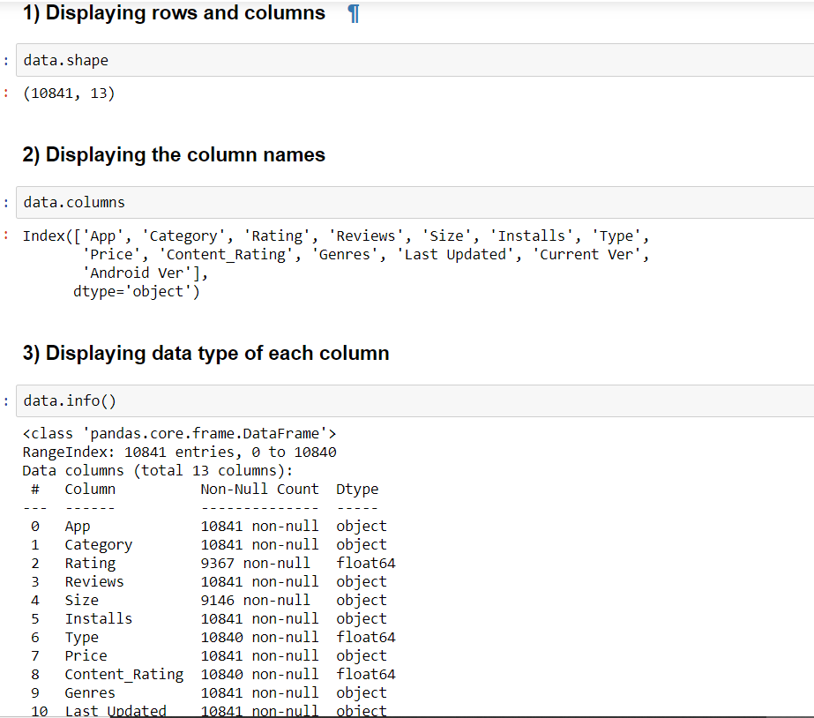
Dataset Information

Slide 10
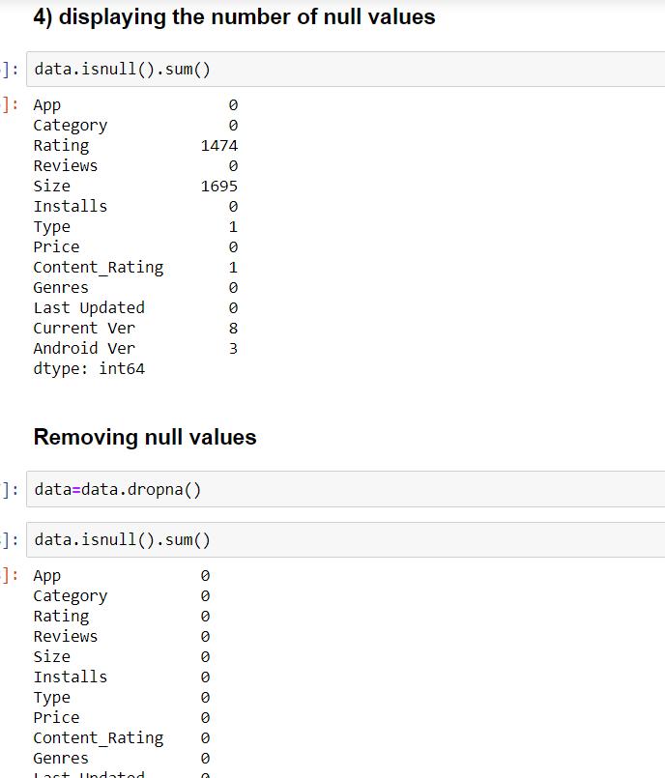
Dealing with Null values

Slide 11
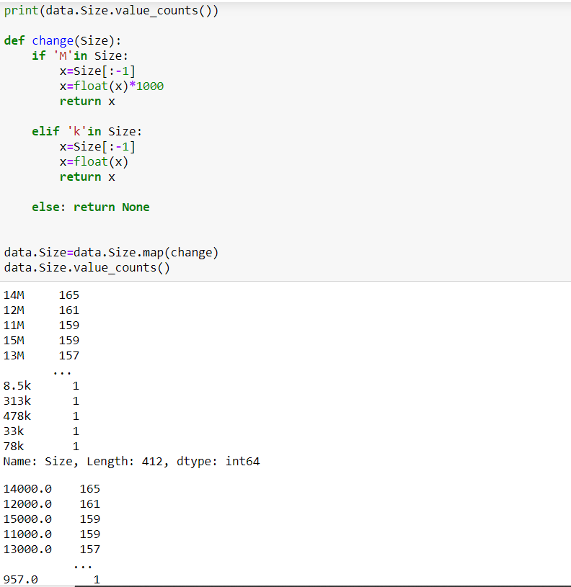
Preprocessing and modifying the columns

Slide 12
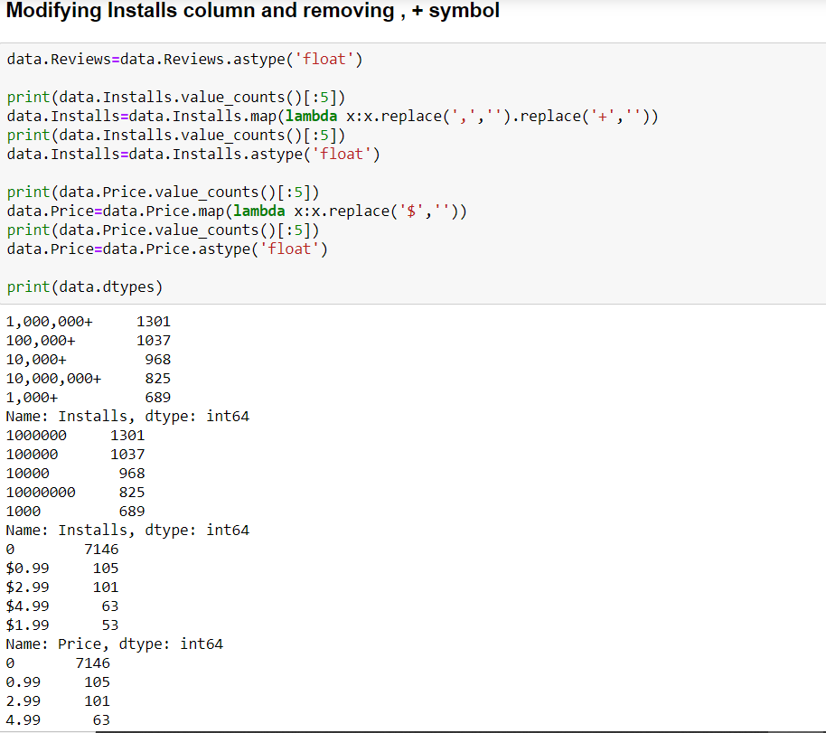
Modifying the install column:

Slide 13
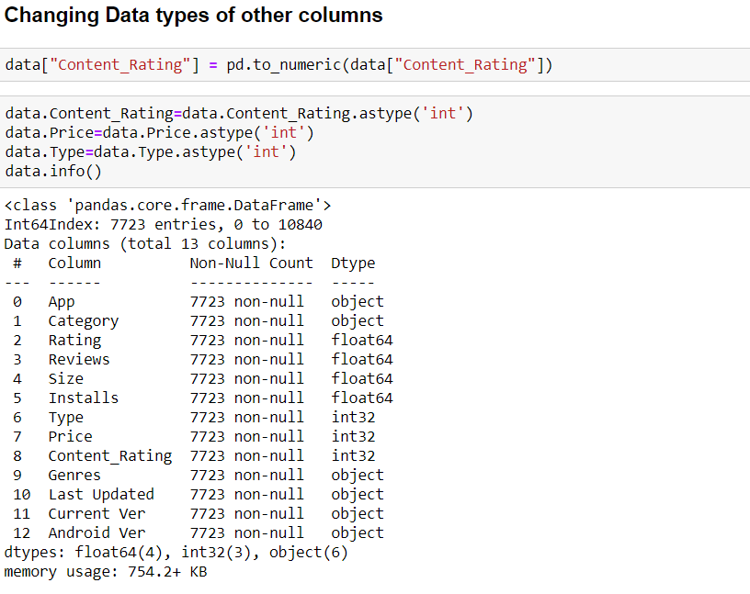
Changing data type of columns:

Slide 14
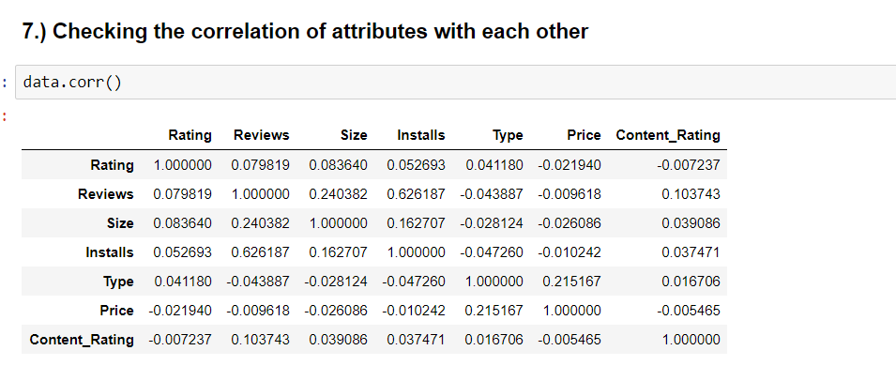
Checking correlation of attributes

Slide 15
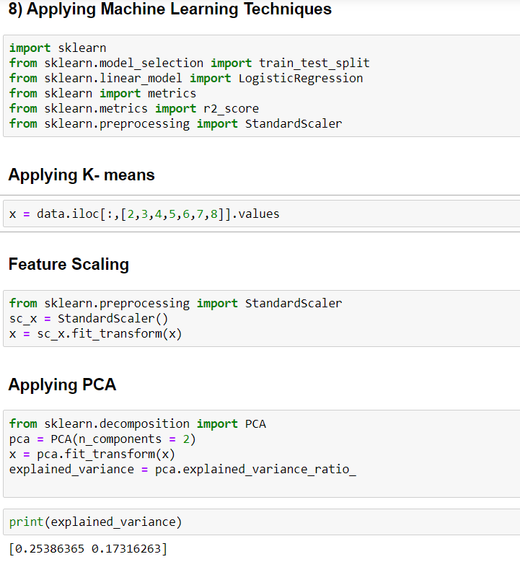
Applying Machine Learning Techniques

Slide 16
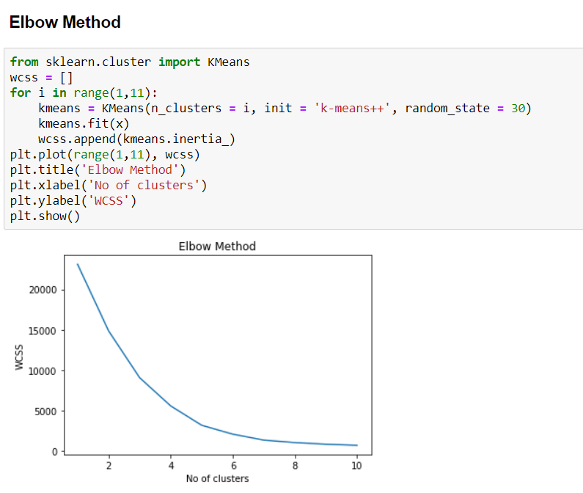
Elbow Method

Slide 17
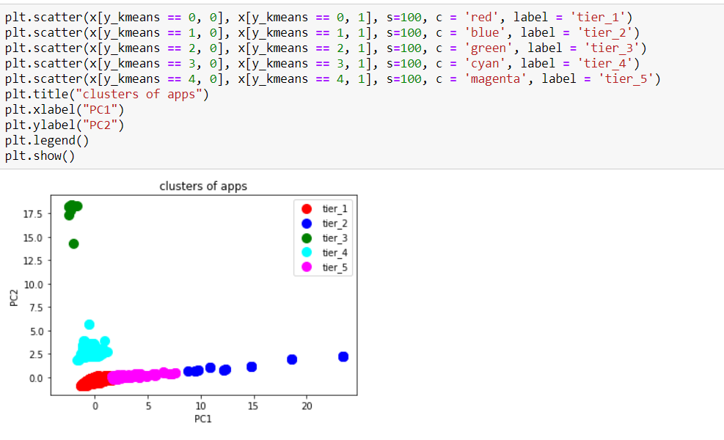
Visualising the cluster

Slide 18
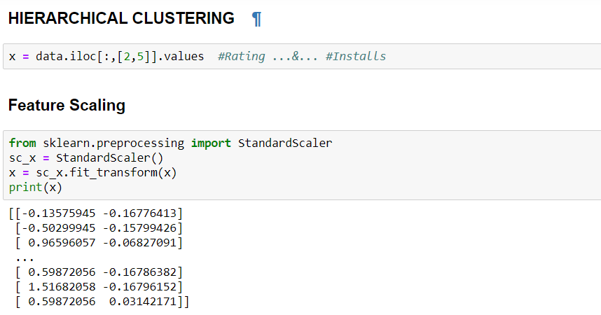
Applying hierarchical clustering

Slide 19
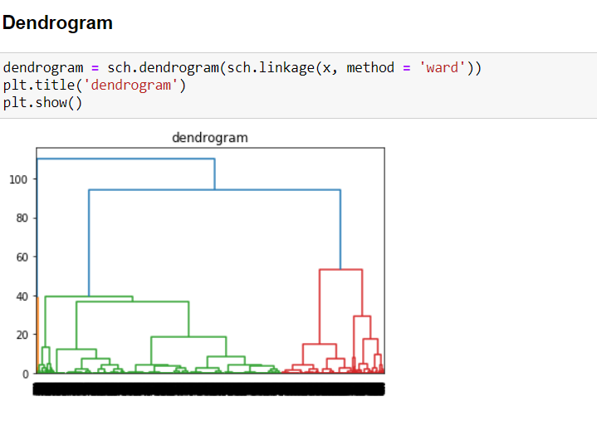
Dendrogram

Slide 20
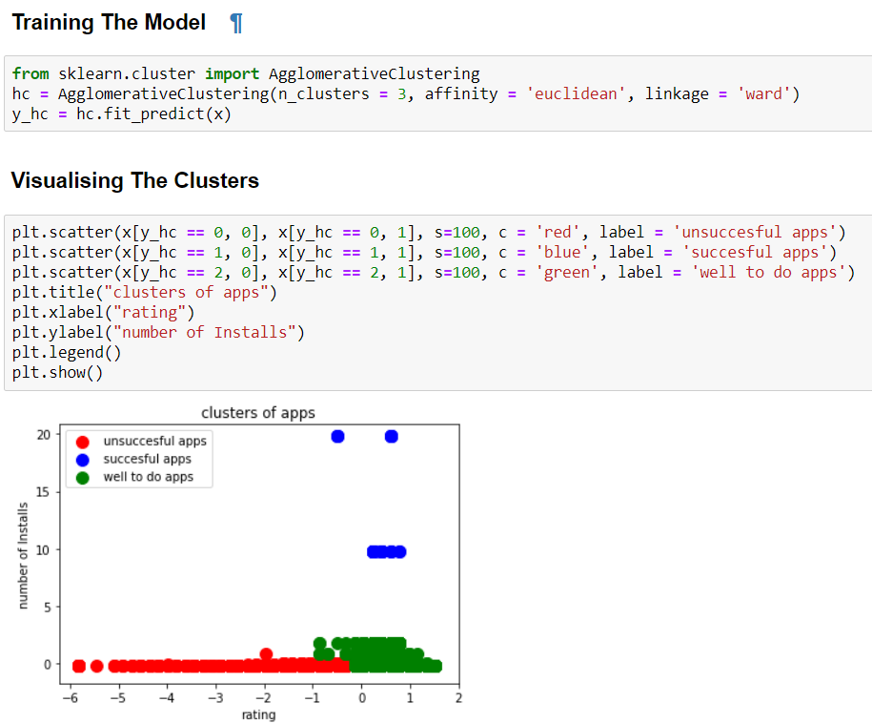
Visualising the clusters

Slide 21
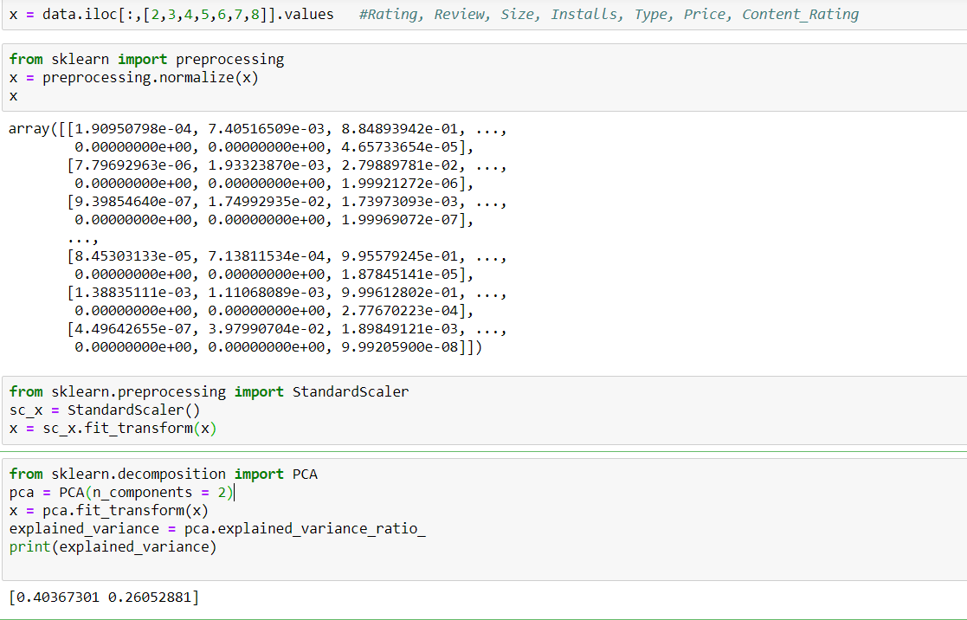
Some more clustering considering more features

Slide 22
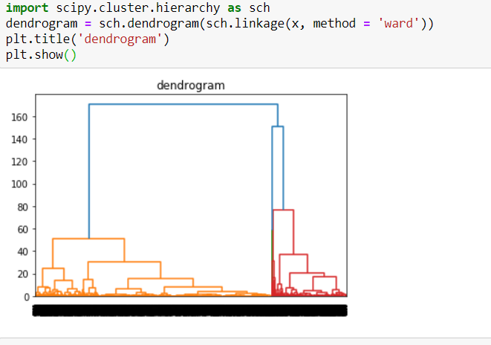
Dendrogram

Slide 23
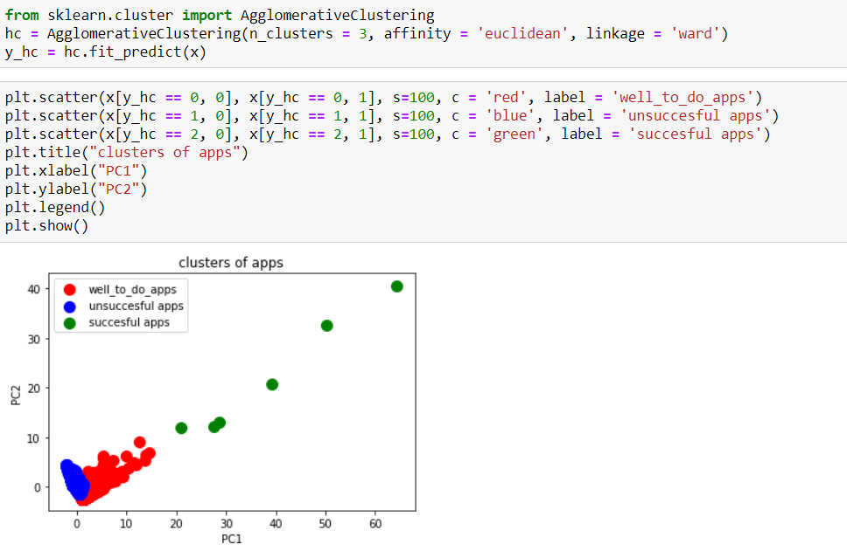
Visualising the Clusters

